Slide 1
1. Quartus 2. Eclipse

Slide 2
NIOSII in Quartus
Repeat all the steps explained in Lab 1.
After that we have to Create
Verilog file
Pin assignment
Compile
Run on FPGA

Slide 3
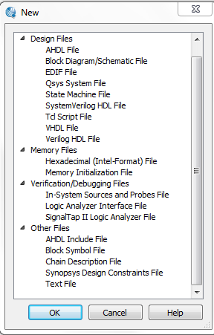
The Next thing to do is Create a Verilog code. In order to do this: Go to File. Hit New. Then select Verilog HDL File.

Slide 4
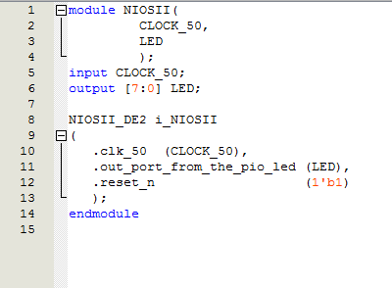
This is Our Verilog HDL code we will be using for this lab.

Slide 5
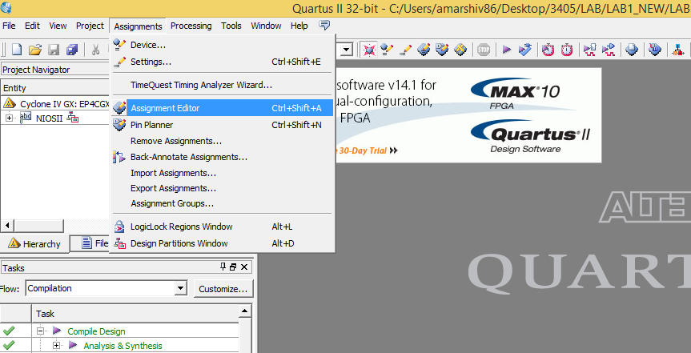

Slide 6
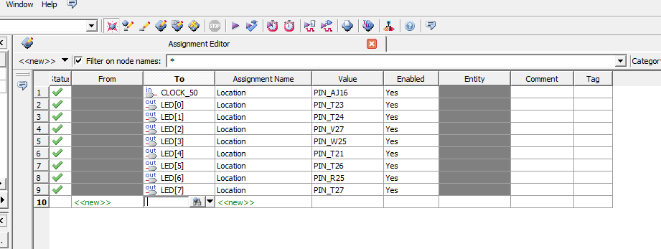

Slide 7
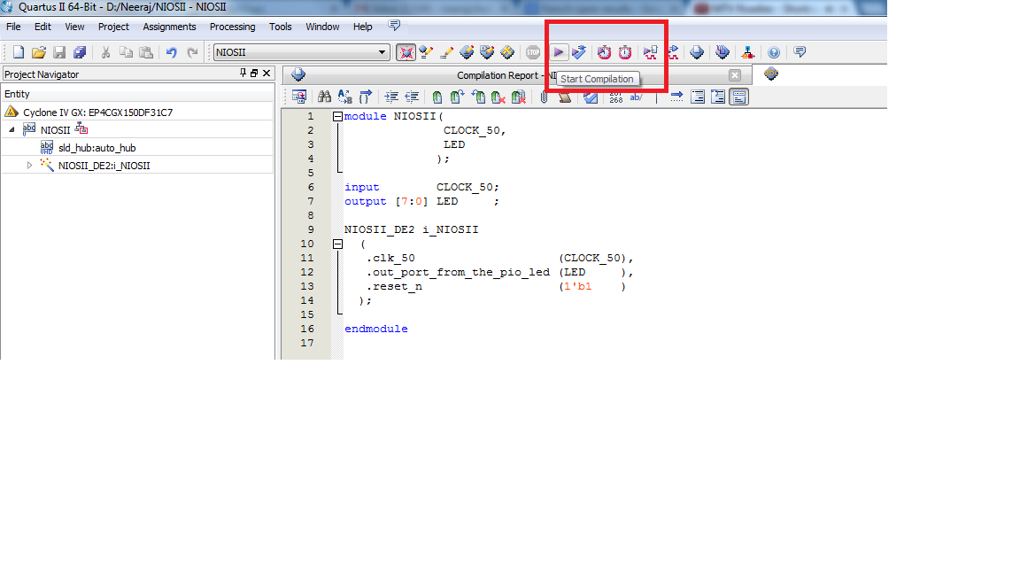
Compile

Slide 8
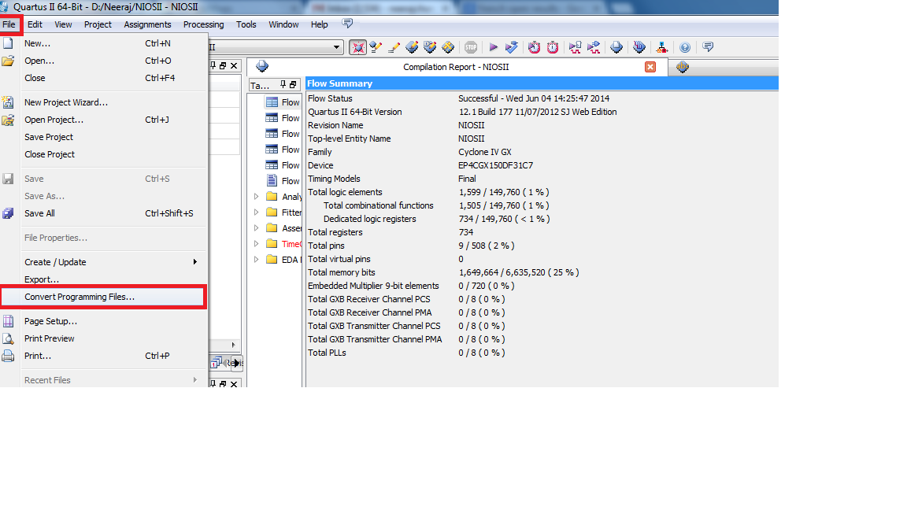
A step towards programming

Slide 9
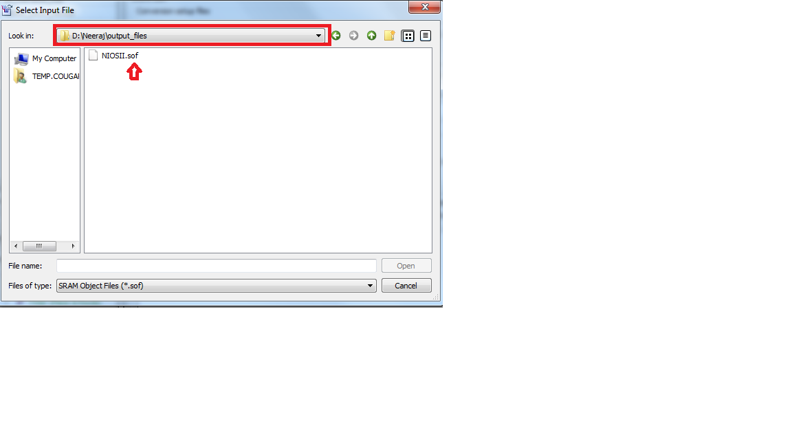

Slide 10
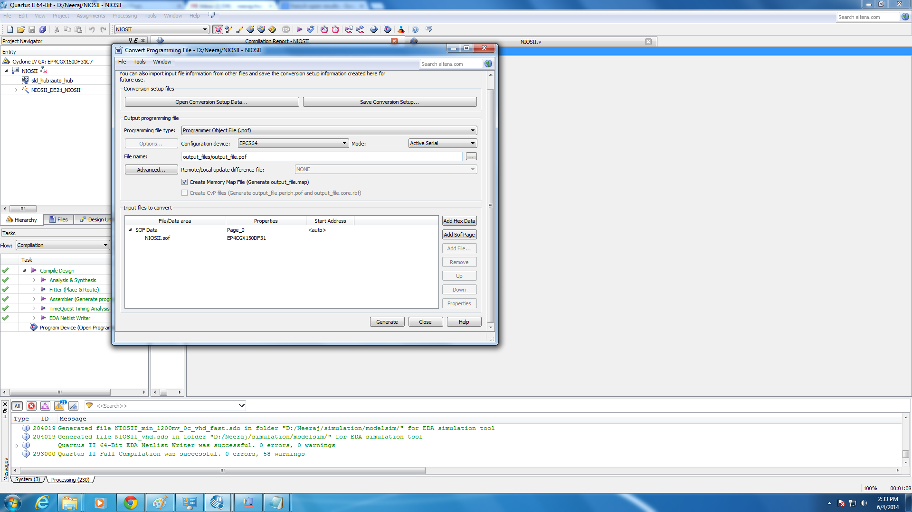

Slide 11
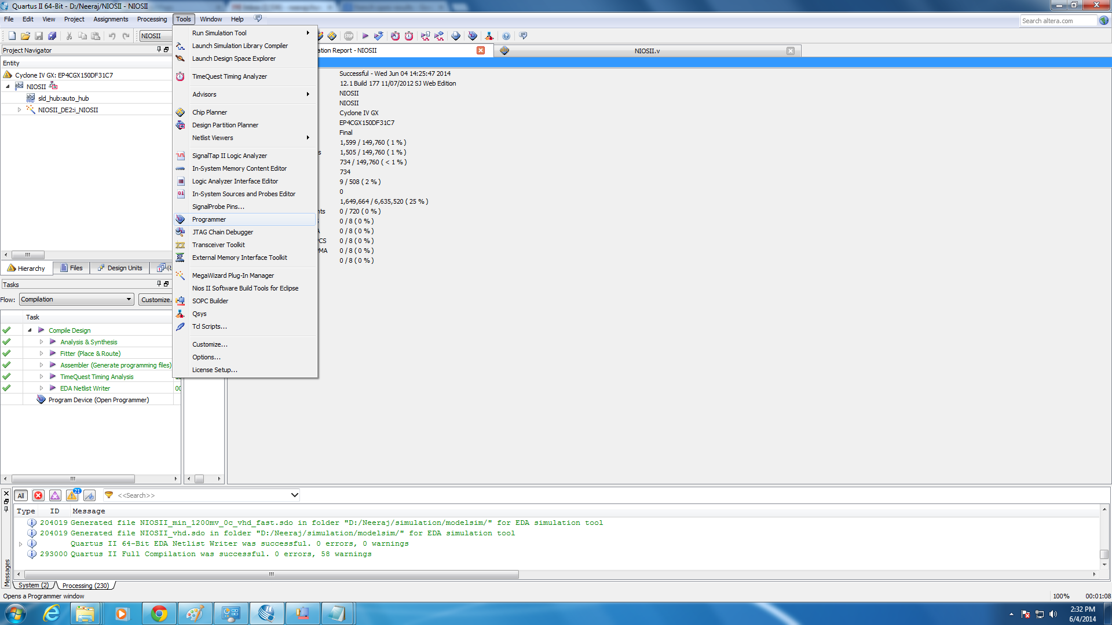

Slide 12
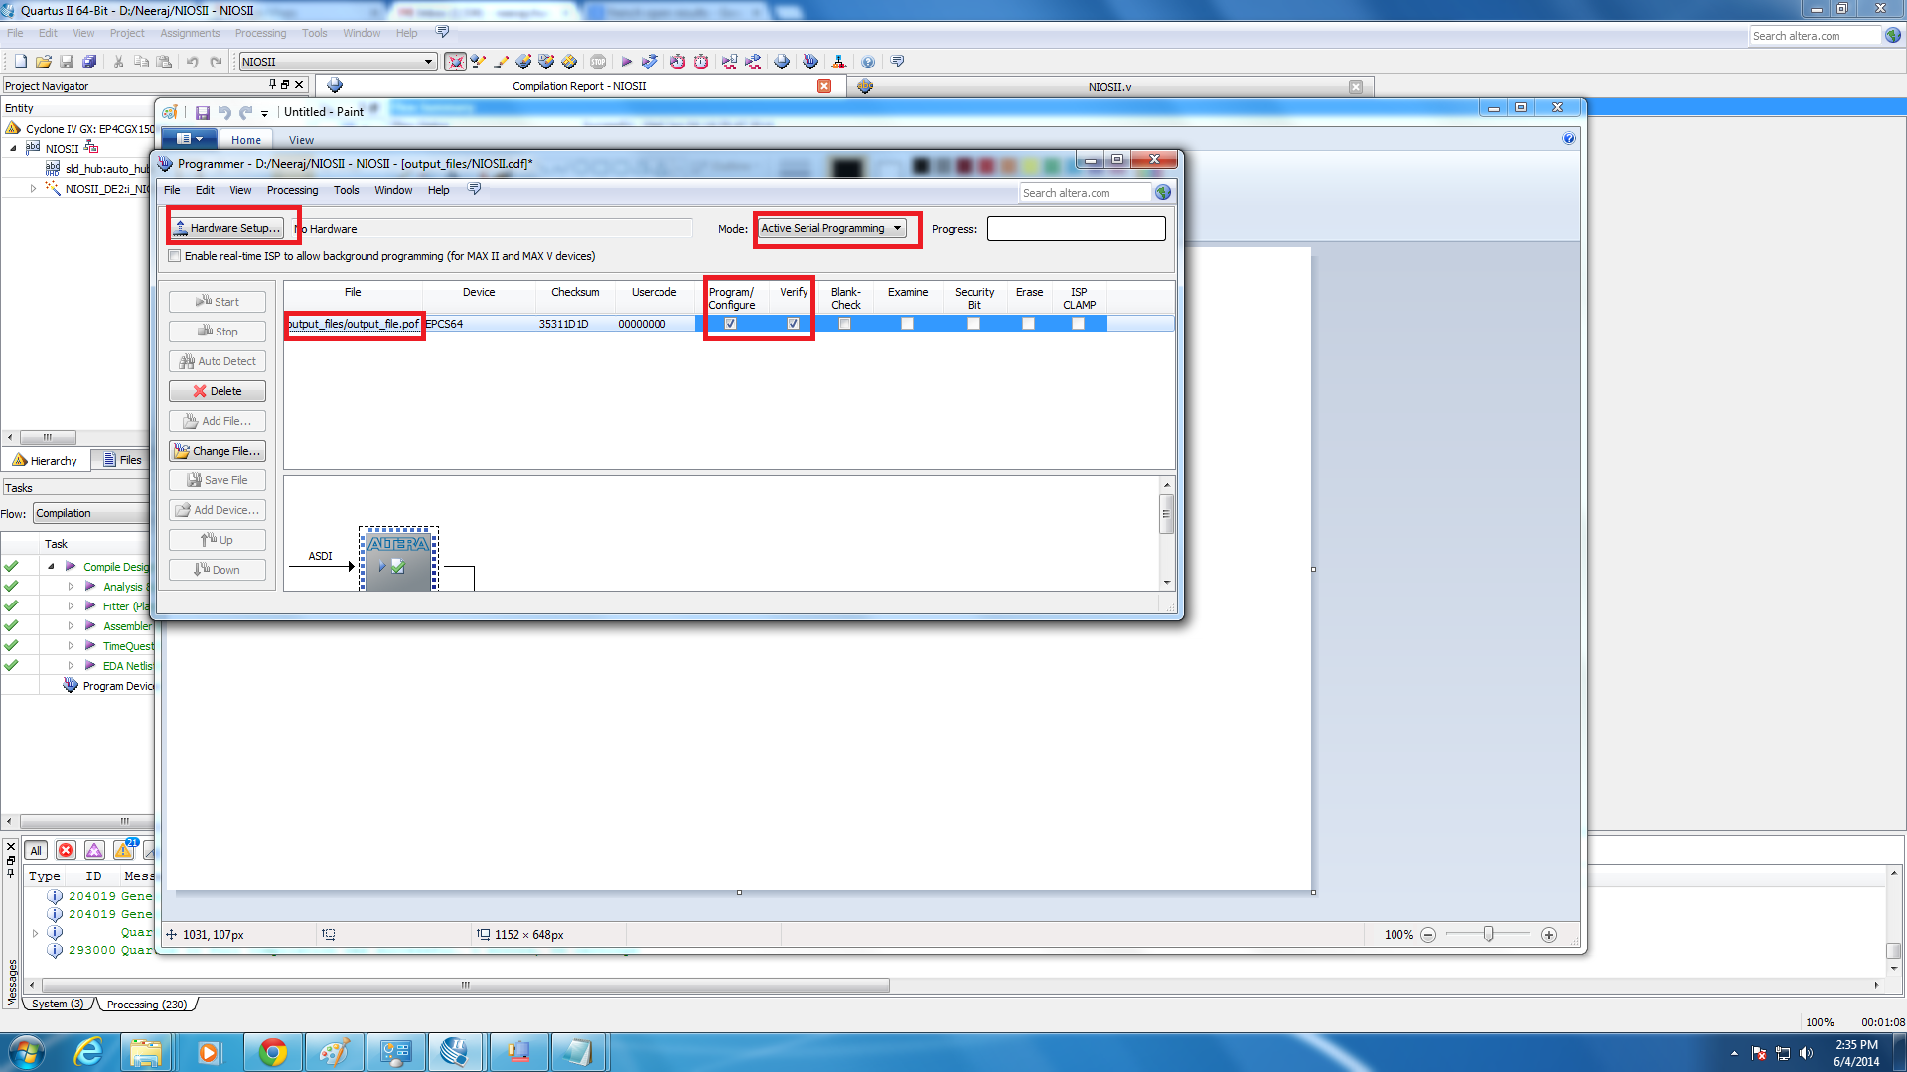

Slide 13
Click on hardware setup and click on usb-blaster after the fpga has been connected via the usb port.
Then change the mode to active serial programming. Click add file add file and find your .pof file that was generated and double click it.
Then check the program/configure box…then click start and your fpga begins to be programmed…after the programmer is done disconnect the usb and turn off the fpga…flip the switch from program to run mode and then turn on the fpga…your loaded program will be running on the fpga

Slide 14
NIOS II 12.1 Software Build Tools for Eclipse

Slide 15
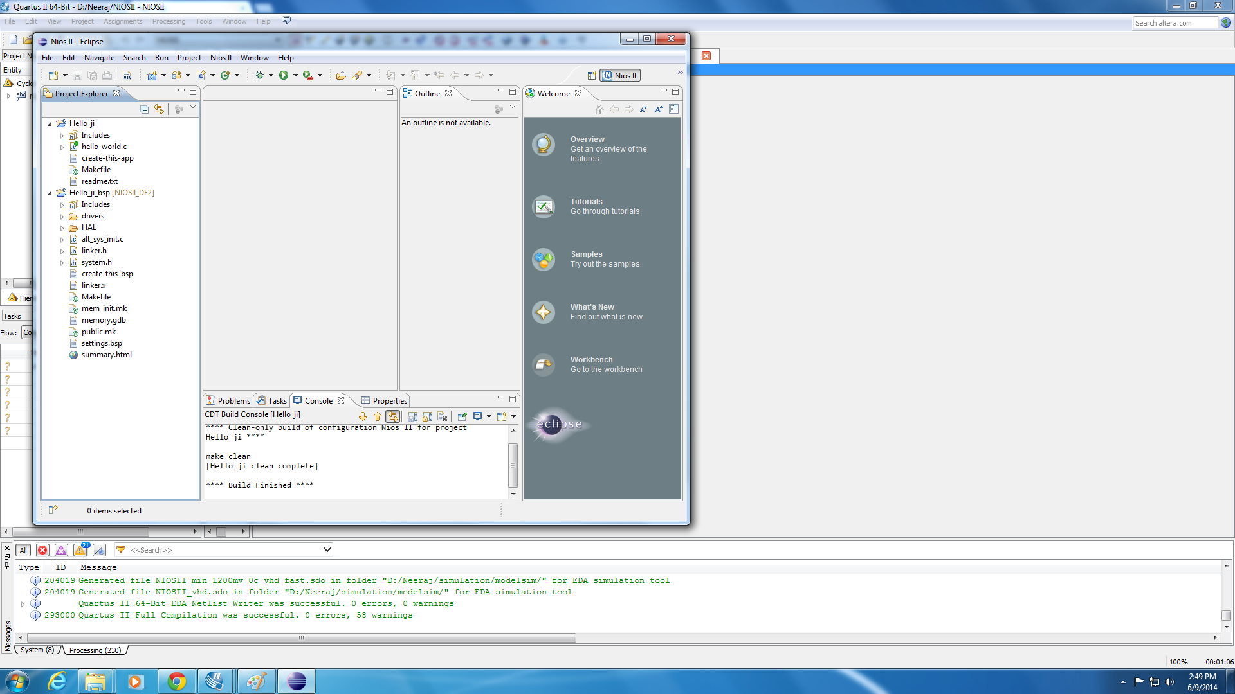
First look
Notes:
This is the home screen that you should get once you start your project.

Slide 16
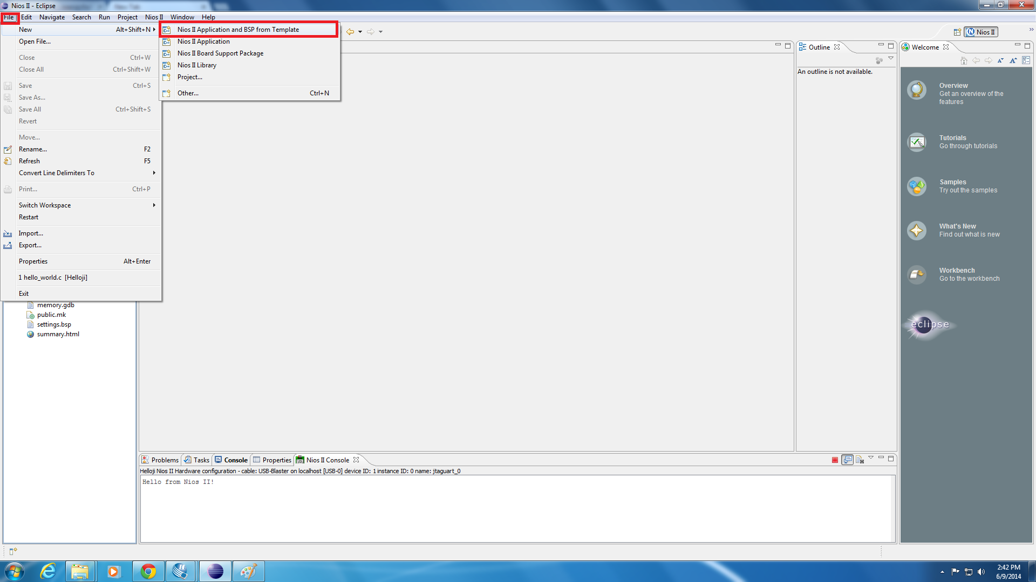
Lets get started…
Notes:
First you need to be in Quartis then hit tools at the top and scroll down to eclipse and select it to open. Then hit new NIOSII Application and BSP from template to get started.

Slide 17
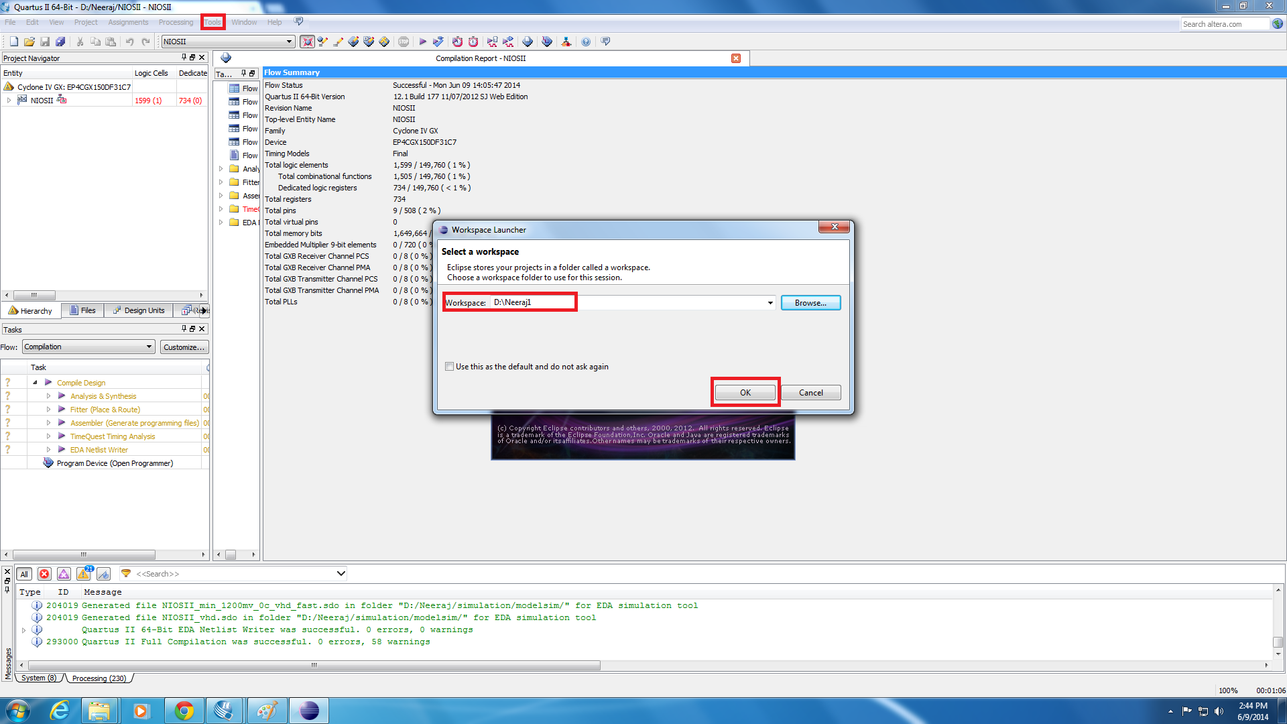
Workspace
Notes:
Next you need to make sure the program is saving the files to the right place on the d drive.

Slide 18
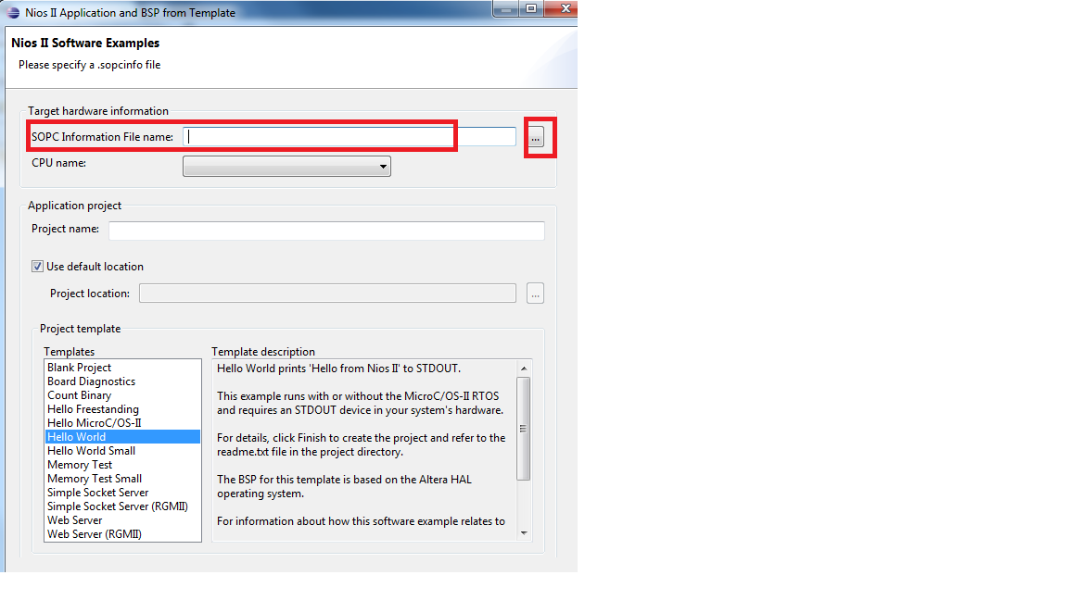
Setting it up
Notes:
Then browse for your NIOSII_DE2.sopcinfo file on the d drive and select it.

Slide 19
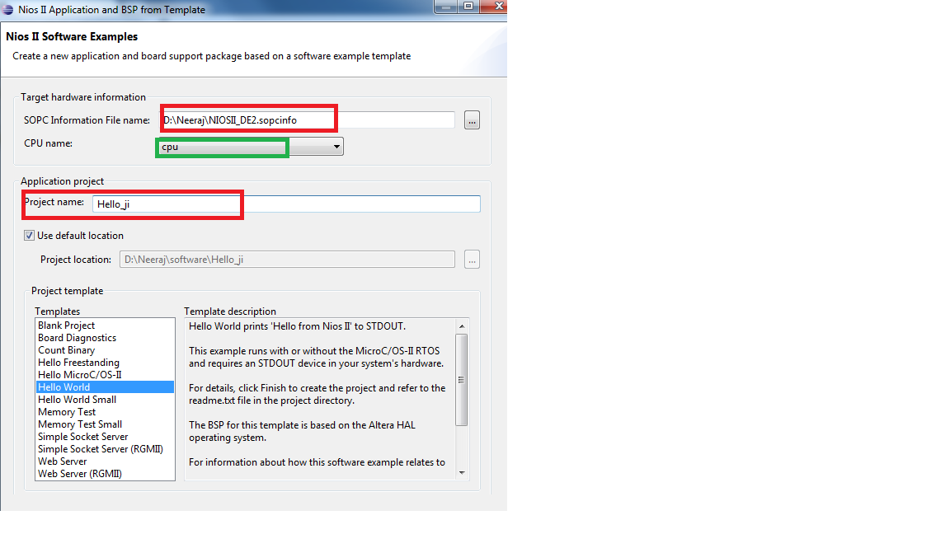
Notes:
Then you need to select the cpu name, which in this case is cpu, and name the project Hello_world. Then select the Hello World project template.

Slide 20
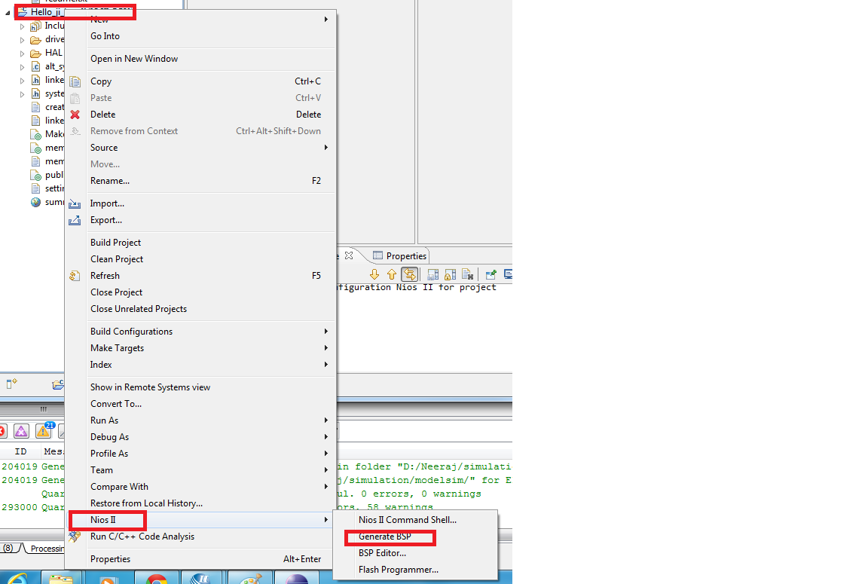
Generate BSP
Notes:
Now we are going to look at our project explore section and right click on the second Hello world folder and then scroll down to NIOS II and select generate BSP.

Slide 21
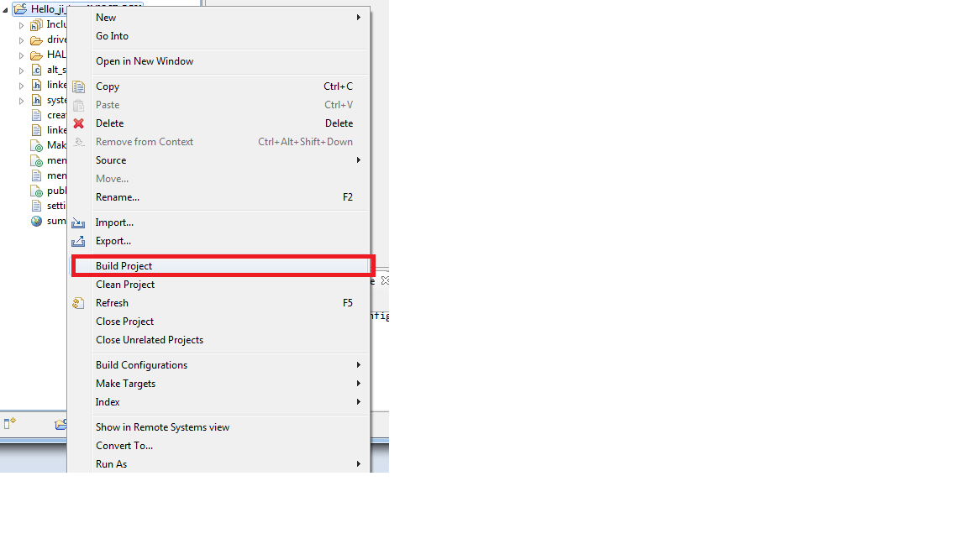
Building the hierarchy
Notes:
Next we are going to build the hierarchy for our project you have to do things in the right order or the application won’t operate properly. First click on the Hello World BSP folder and scroll down and click Build Project.

Slide 22
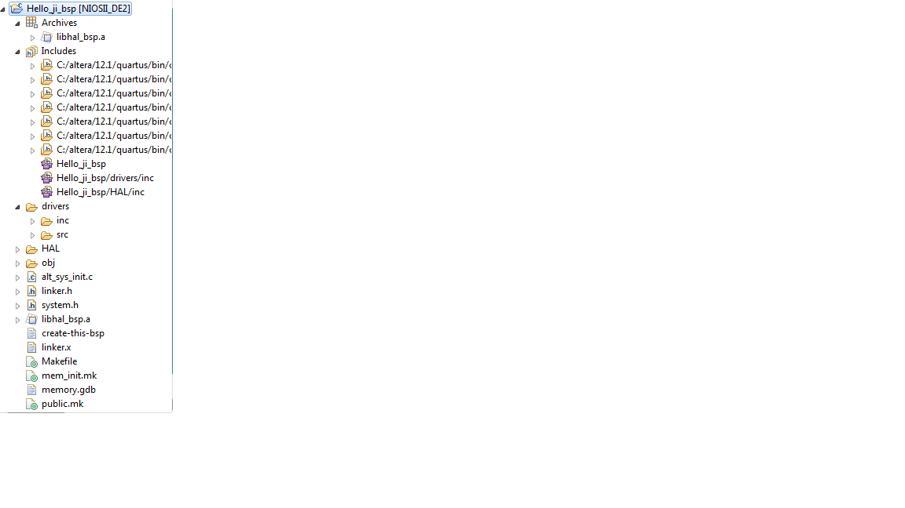

Slide 23
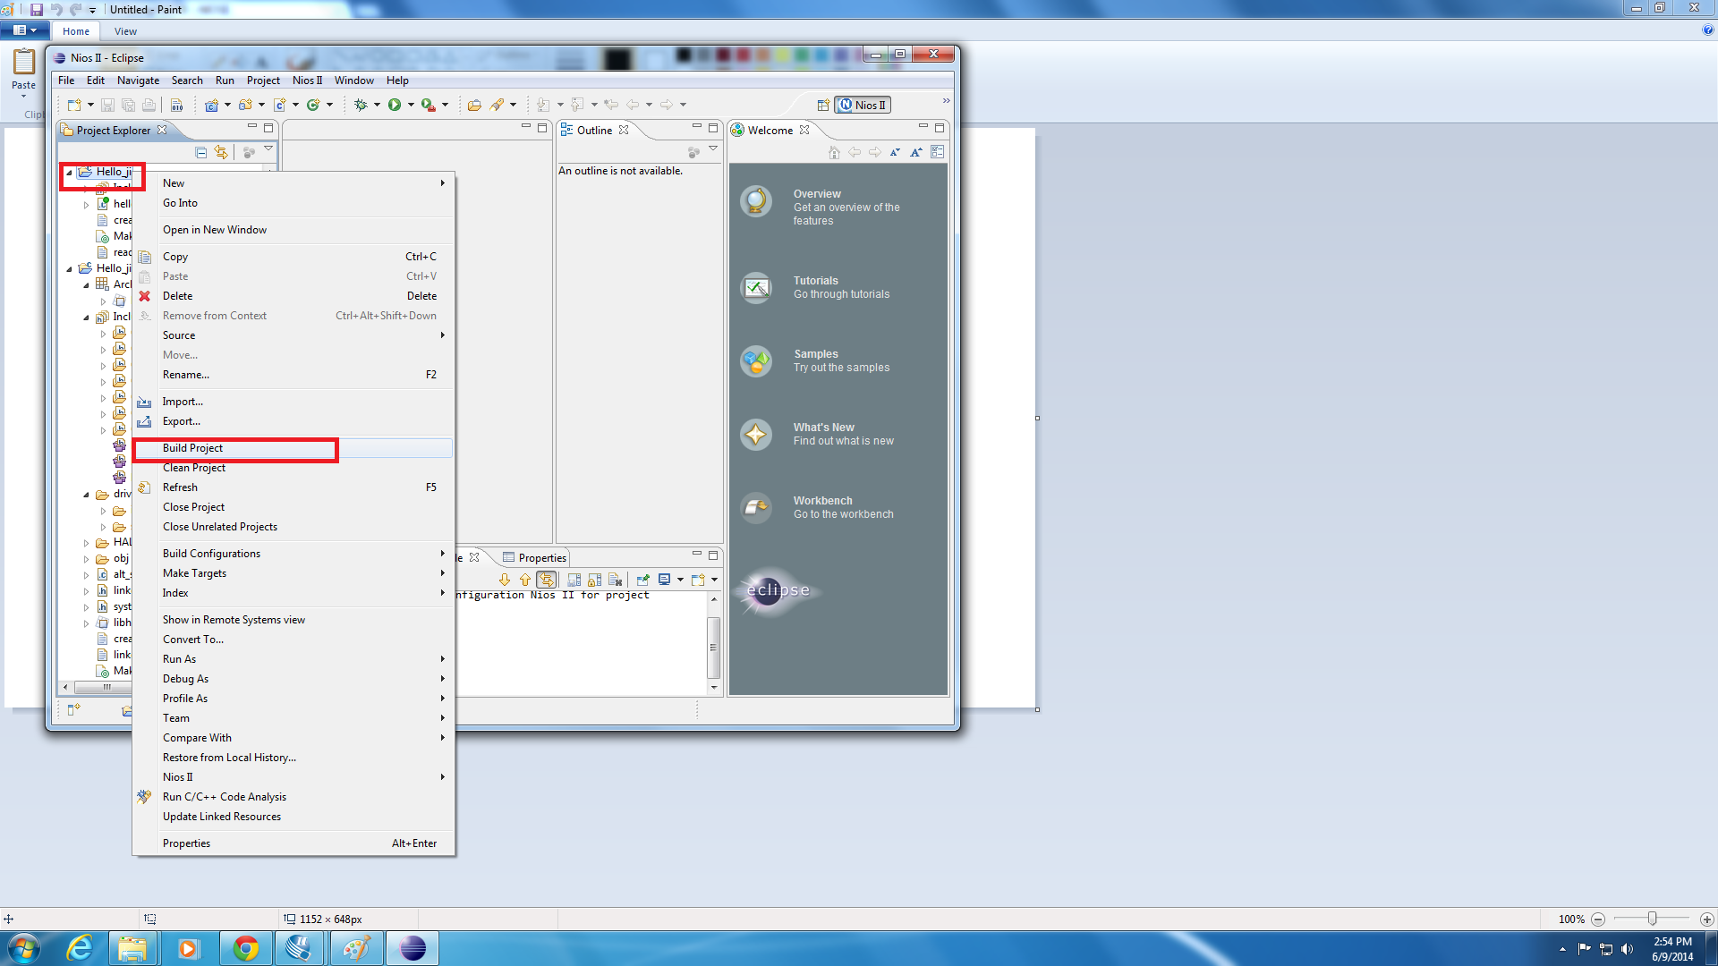
Building contd…..
Notes:
Now we right click on the Hello World folder and scroll down and select build project.

Slide 24
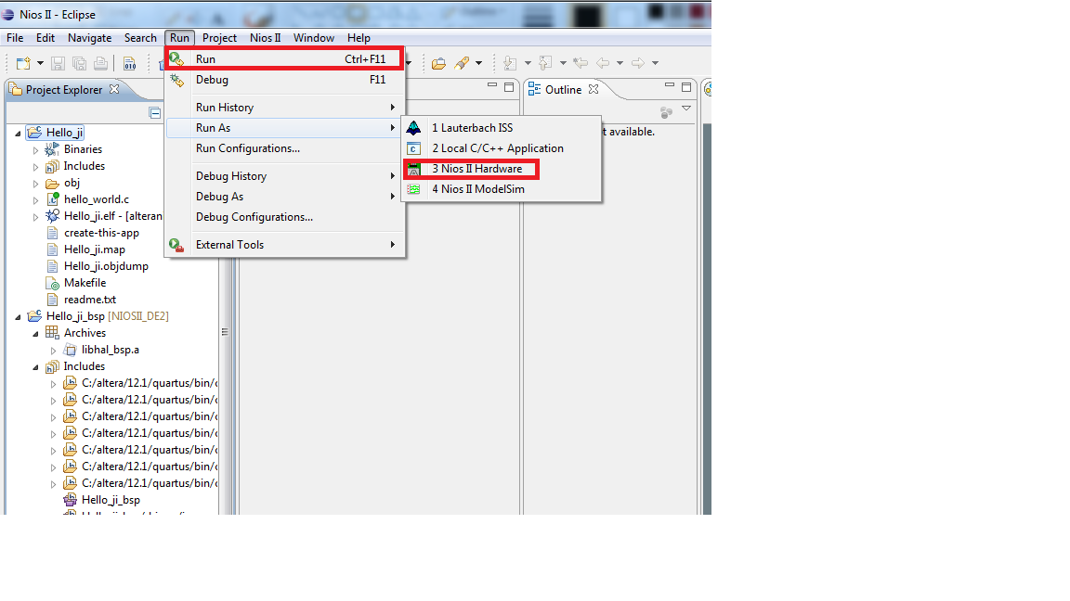
Run: Take care of the SWITCH
Notes:
Now we are going to run the application and see if it runs properly. First make sure you have the first hello world folder selected. Then select run at the top of the screen then select run NIOSII Hardware.

Slide 25
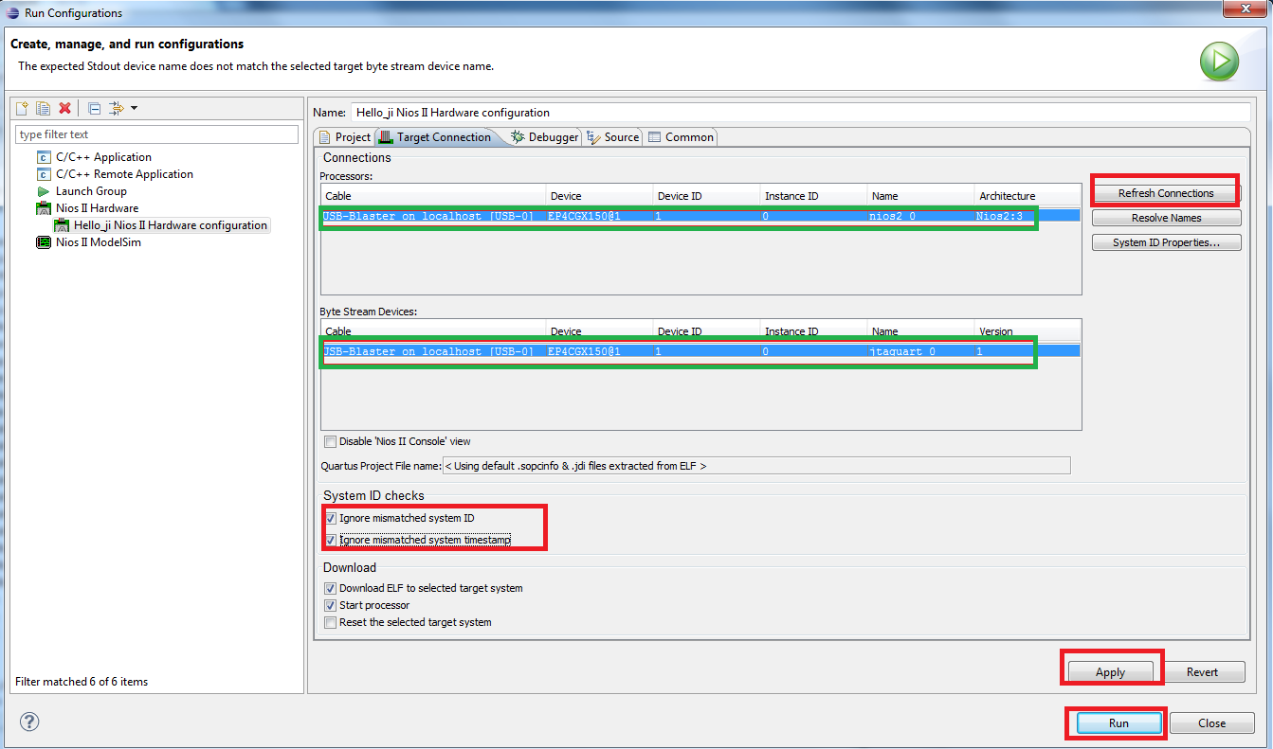
Refresh Connections
Notes:
Now make sure that your fpga board is plugged in and on in run mode and then make sure your usb blaster shows up in the connections if it doesn’t make sure your board is in run mode and on then hit refresh connections. Then select usb blaster then make sure under system ID checks you have selected both ignore mismatched system ID and Ignore mismatched system timestamp. Then hit apply and then hit run.

Slide 26
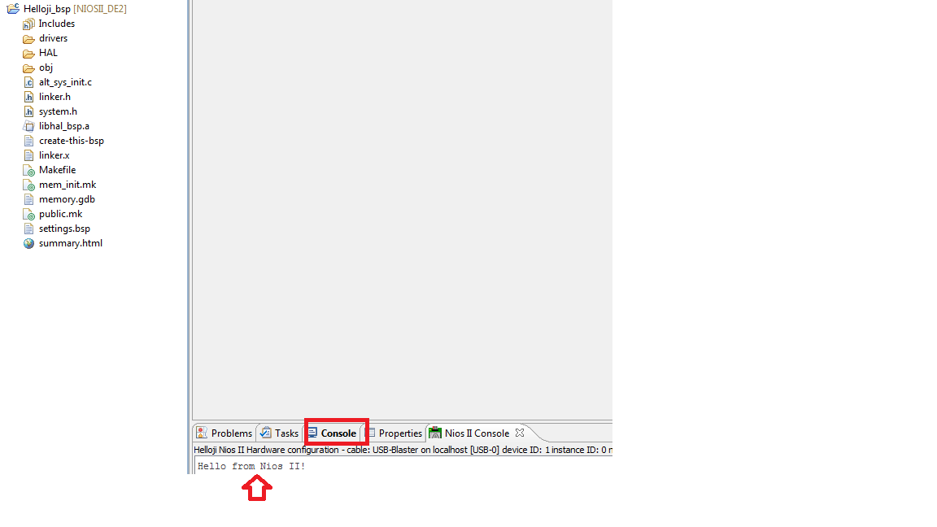
Project Accomplished
Notes:
And if everything works right at the bottom of the screen under the console section you should see the words “Hello from Nios II!”. And you are done.

